Slide 1
Clocks and Watches Figures

Slide 2
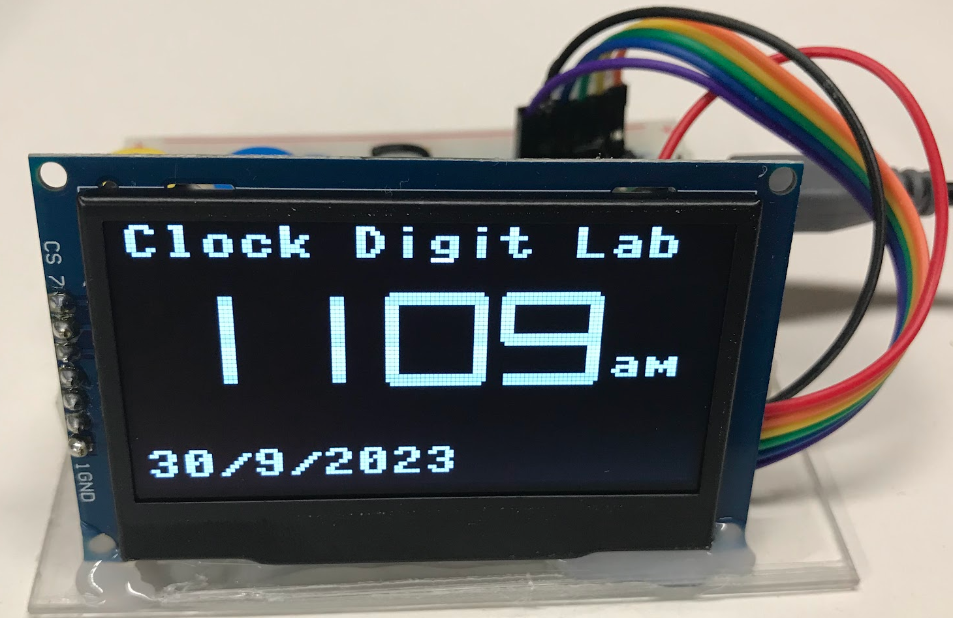
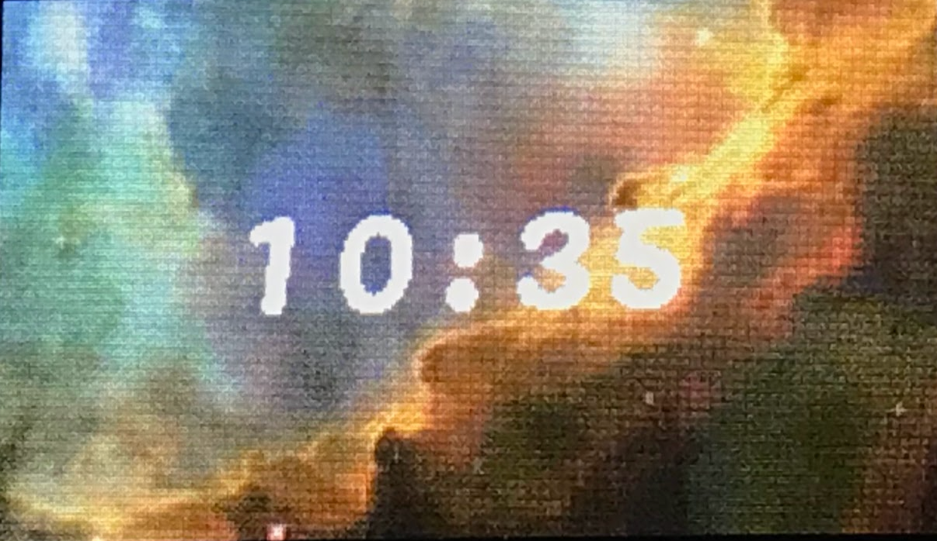
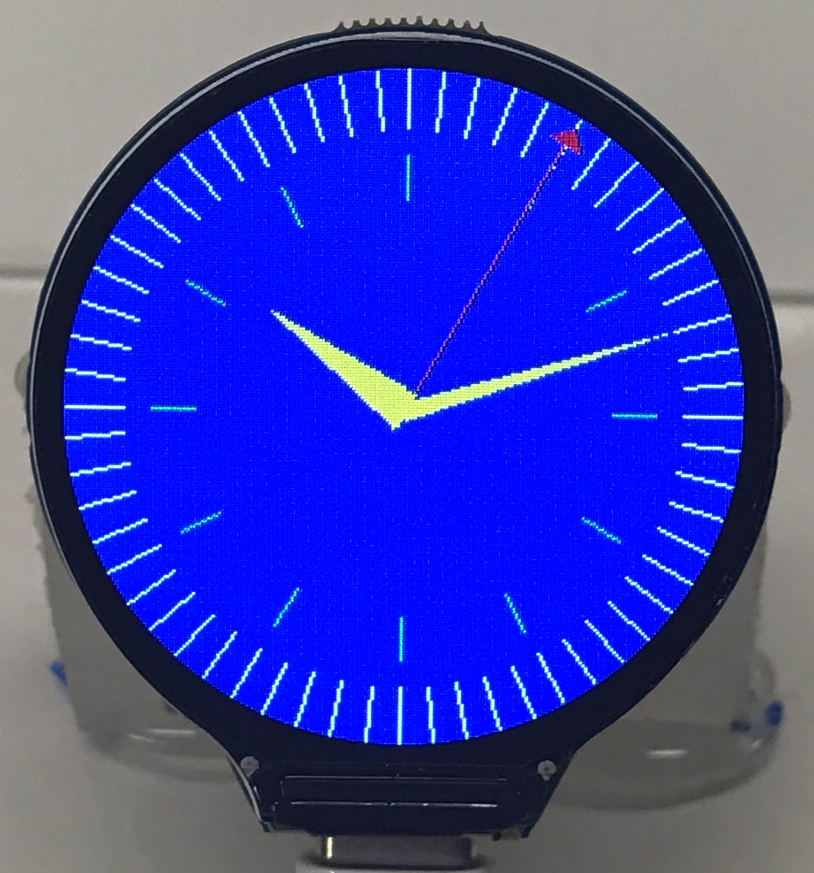
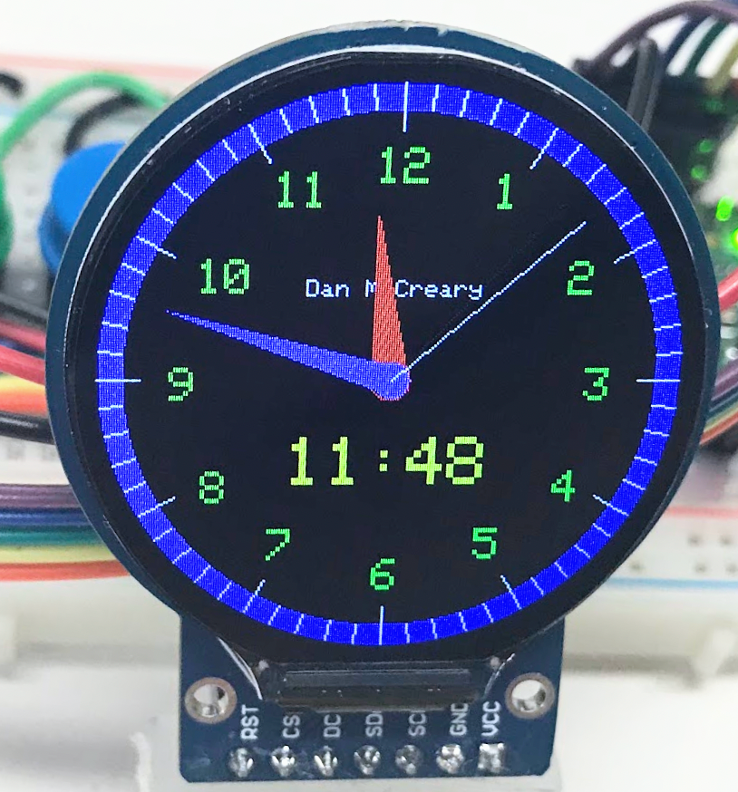
Banner
banner

Slide 3
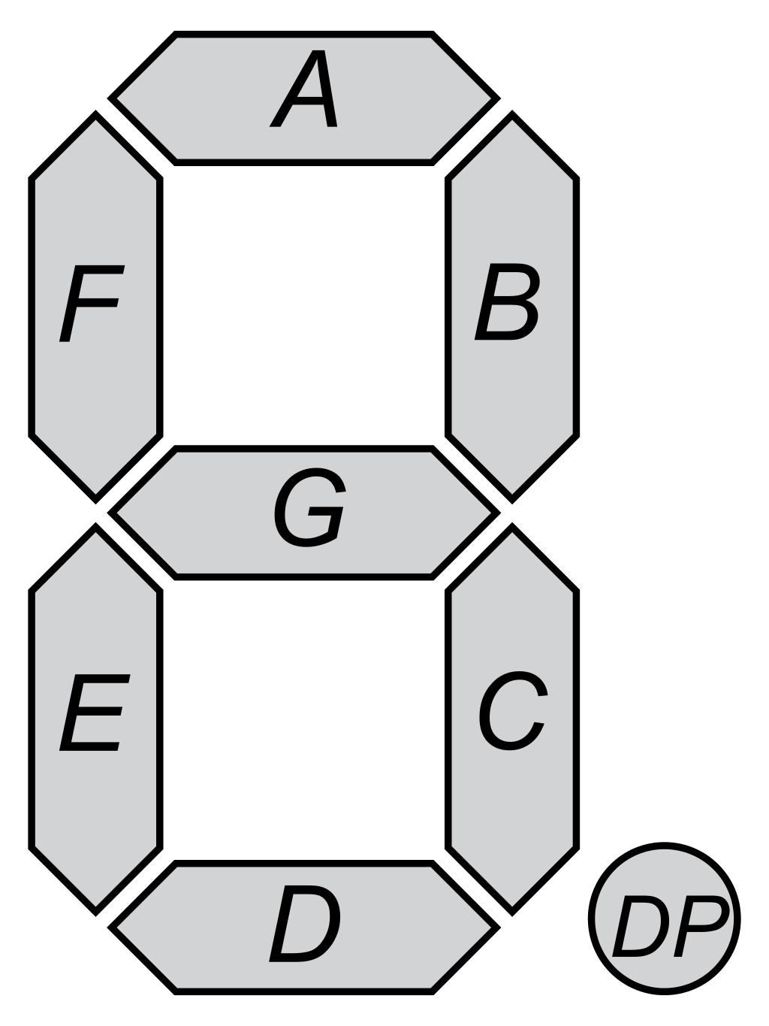
5
0
1
6
4
2
3

Slide 4
5
0
1
5
0
1
6
6
4
2
4
2
3
3

Slide 5
(X,Y)
0
(X,Y – (height//2)-(thickness //2)
6
(X,Y-thickness)
3

Slide 6
(X,Y)
(X - thickness, Y)
5
0
1
(X, Y + height//2)
6
(X + width - thickness, Y + height//2)
4
2
3

Slide 8
Digital Clock Display
x1
x3
x3
x3
y2
x4
x2
x5
x8
am
y1
y3
x7
x6

